Slide 1
Module II Classification and Prediction
Jisha Babu

Slide 2
Classification vs. Prediction
Classification
classifier is constructed to predict categorical labels
Prediction
models continuous-valued functions, i.e., predicts unknown or missing values

Slide 3
Classification—A Two-Step Process
Learning
“learning from” a training set made up of database tuples and their associated class labels
The set of tuples used for model construction is training set
Classification
Test data are used to estimate the accuracy of the classification rules.
If the accuracy is considered acceptable, the rules can be applied to the classification of new data tuples.

Slide 4
Process (1): Model Construction
Classification
Algorithms
Training
Data
Classifier
(Model)
IF rank = ‘professor’
OR years > 6
THEN tenured = ‘yes’

Slide 5
Process (2): Using the Model in Prediction
Classifier
Testing
Data
Unseen Data
(Jeff, Professor, 4)
Tenured?

Slide 6
Issues: Data Preparation
Data cleaning
Preprocess data in order to reduce noise and handle missing values
Relevance analysis (feature selection)
Remove the irrelevant or redundant attributes
Data transformation
Generalize and/or normalize data

Slide 7
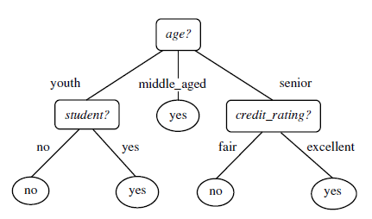
Classification by Decision Tree Induction
A decision tree is a flowchart-like tree structure, where each internal node denotes a test on an attribute, each branch represents an outcome of the test, and each leaf node holds a class label.

Slide 8
Algorithm
Input
D, attribute list, and Attribute selection method
Method
The tree starts as a single node, N
If the tuples in D are all of the same class, then node N becomes a leaf and is labeled with that class
Else the algorithm calls Attribute selection method to determine the splitting criterion.
The node N is labeled with the splitting criterion, which serves as a test at the node
The tuples in D are partitioned according to the outcomes

Slide 9
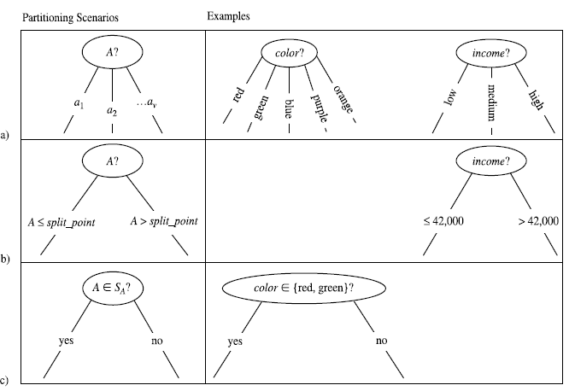
Possible scenarios

Slide 10
Attribute Selection Measure
selecting the splitting criterion that “best” separates a given data into individual classes
Three measures
Information Gain
gain ratio
gini index.

Slide 11
Attribute Selection Measure: Information Gain (ID3/C4.5)
Select the attribute with the highest information gain
Expected information (entropy) needed to classify a tuple in D:
Let p_{i} be the probability that an arbitrary tuple in D belongs to class C_{i}, estimated by |C_{i, D}|/|D|
Expected Information needed to classify a tuple from D:
Information gained by branching on attribute A
Notes:
I : the expected information needed to classify a given sample
E (entropy) : expected information based on the partitioning into subsets by A

Slide 12
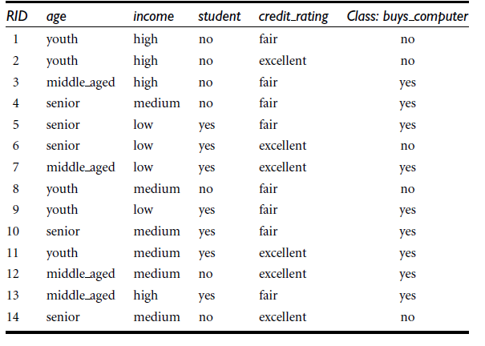
example

Slide 13

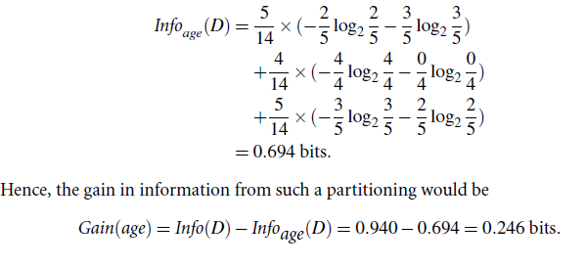

Slide 14
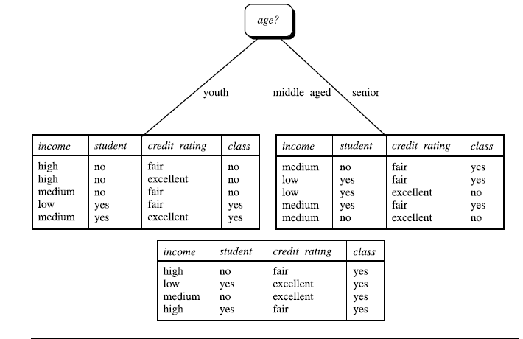

Slide 15


Gain Ratio
normalization to information gain using a “split information” value defined analogously with Info(D) as
The gain ratio is defined as

Slide 16

Gini index
the Gini index measures the impurity of D
where p_{i} be the probability that an arbitrary tuple in D belongs to class C_{i}, estimated by
|C_{i, D}|/|D|
The Gini index considers a binary split for each attribute

Slide 17

To determine the best binary split on A, we examine all of the possible subsets that can be formed using known values of A.
if a binary split on A partitions D into D1 and D2, the gini index of D given that partitioning is

Slide 18

Bayesian Classification
Predict class membership probabilities
Bayes’ Theorem :

Slide 19

Algorithm
Let D be a training set of tuples and their associated class labels.
Bayesian classifier predicts that tuple X belongs to the class Ci if and only if

Slide 20


Slide 21
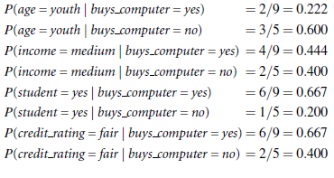

Slide 22
Rule-Based Classification
A rule-based classifier uses a set of IF-THEN rules for classification
The “IF”-part (or left-hand side)of a rule is known as the rule antecedent or precondition.
The “THEN”-part (or right-hand side) is the rule consequent.

Slide 23

Coverage and Accuracy

Slide 24
Rule Extraction from a Decision Tree
To extract rules from a decision tree, one rule is created for each path from the root to a leaf node
Each splitting criterion along a given path is logically ANDed to form the rule antecedent (“IF” part).
The leaf node holds the class prediction, forming the rule consequent (“THEN” part).

Slide 25
Rule Induction Using a Sequential Covering Algorithm
IF-THEN rules can be extracted directly from the training data using a sequential covering algorithm.
Rules are learned one class at a time

Slide 26
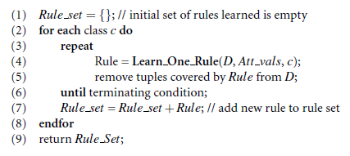

Slide 27
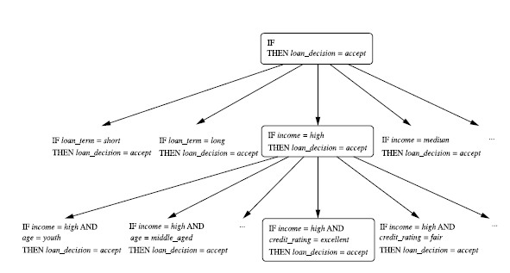

Slide 28
Rule Quality Measures
Every time it considers an attribute test, it must check to see if appending such a test to the current rule’s condition will result in an improved rule.

Slide 29
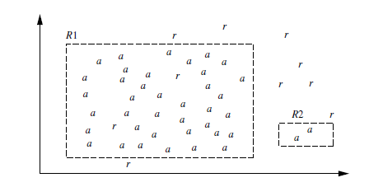

Slide 30
Classification by Backpropagation
Backpropagation is a neural network learning algorithm
A neural network: A set of connected input/output units where each connection has a weight associated with it
A Multilayer Feed-Forward Neural Network
consists of an input layer, one or more hidden layers, and an output layer
Each layer is made up of units

Slide 31
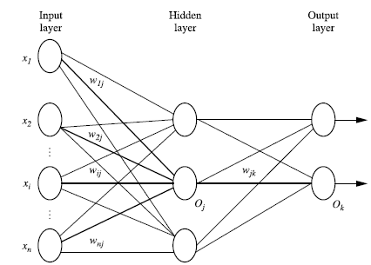

Slide 32
Algorithm
Initialize the weights
Propagate the inputs forward
Backpropagate errors

Slide 33
A Multi-Layer Feed-Forward Neural Network
Output vector
Output layer
Hidden layer
w_{ij}
Input layer
Input vector: X

Slide 34
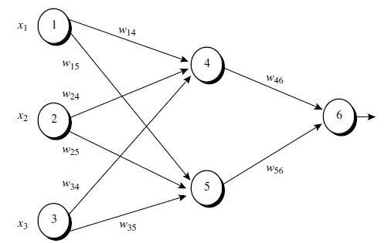
A Multilayer Feed-Forward Neural Network

Slide 35
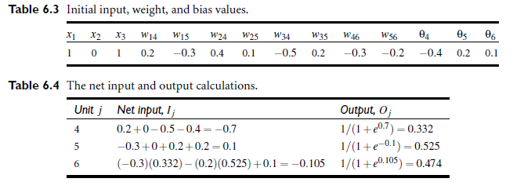

Slide 36
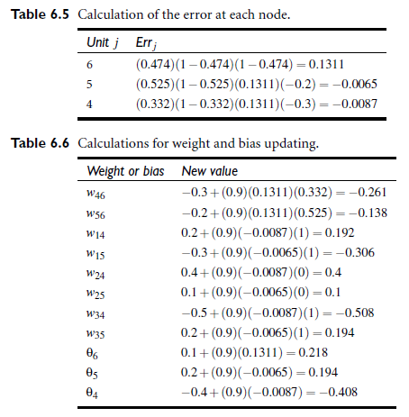

Slide 37
Support Vector Machines
new method for the classification of both linear and nonlinear data
Represent the tuples in space mapped so that separate categories are divided by a clear gap that is wide as possible

Slide 38
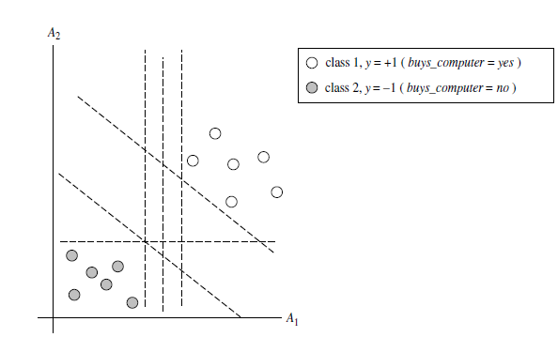

Slide 39
There are an infinite number of separating lines that could be drawn. We want to find the “best”

Slide 40
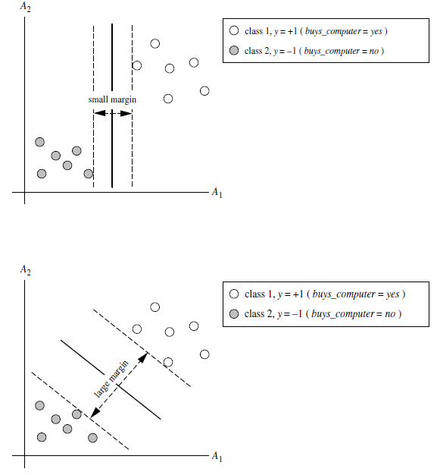

Slide 41
larger margin to be more accurate at classifying future data tuples than the hyperplane with the smaller margin
Maximum Marginal Hyperplane(MMH)
A separating hyperplane can be written as:
W.X+b=0

Slide 42
any point that lies above the separating hyperplane satisfies
w0+w1x1+w2x2 > 0
any point that lies below the separating hyperplane satisfies
w0+w1x1+w2x2 < 0:

Slide 43

H1 : w0+w1x1+w2x2 >= 1 for yi = +1,
H2 : w0+w1x1+w2x2 <= 1 for yi = -1
Any training tuples that fall on hyperplanes H1 or H2 are called support vectors.
To classify test tuple

Slide 44
Prediction

Slide 45
Prediction
Numeric prediction is the task of predicting continuous values for given input.
Regression
To model the relationship between one or more predictor variables and a response variable
Common methods:
Linear Regression
Non-linear Regression

Slide 46
Linear Regression
Straight-line regression analysis involves a response variable, y, and a single predictor variable, x.
y=b+wx

Slide 47
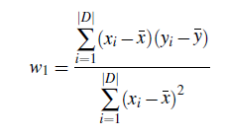
method of least squares
Estimates best-fitting straight line as the one that minimizes the error between the actual data and the estimate of the line

Slide 48
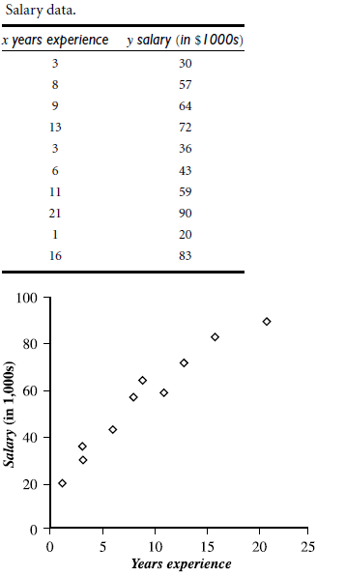
Example

Slide 49
Nonlinear Regression
Convert the nonlinear model into a linear one that can then be solved by the method of least squares.

Slide 50
Accuracy and Error Measures
what is accuracy?
How can we estimate it?
Are there strategies for increasing the accuracy of a learned model?

Slide 51
Classifier Accuracy Measures
accuracy is better measured on a test set consisting of class-labeled tuples that were not used to train the model
Accuracy or recognition rate

Slide 52
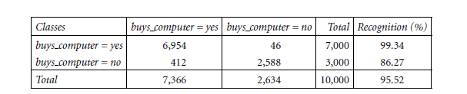
confusion matrix

Slide 53
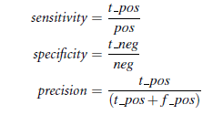

Accuracy Measure
The sensitivity and specificity measures
Sensitivity is also referred to as the true positive (recognition) rate
Specificity is the true negative rate

Slide 54

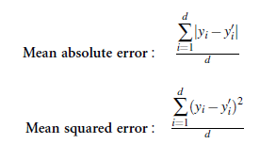
Predictor Error Measures
how far off the predicted value is from the actual known value
Loss functions measure the error between predicted value and actual known value
Error Rates

